Slide 1
Cloud and DevOPs
Topic: “Automate provisioning and configuration of NGINX server in Docker container with SSL certificate with 2 duplicate servers in AWS cloud using Jenkins, Ansible, Terraform.”
Presented by
Name:Akshay Gupta Registration Number:11913896
Lovely Professional University

Slide 2
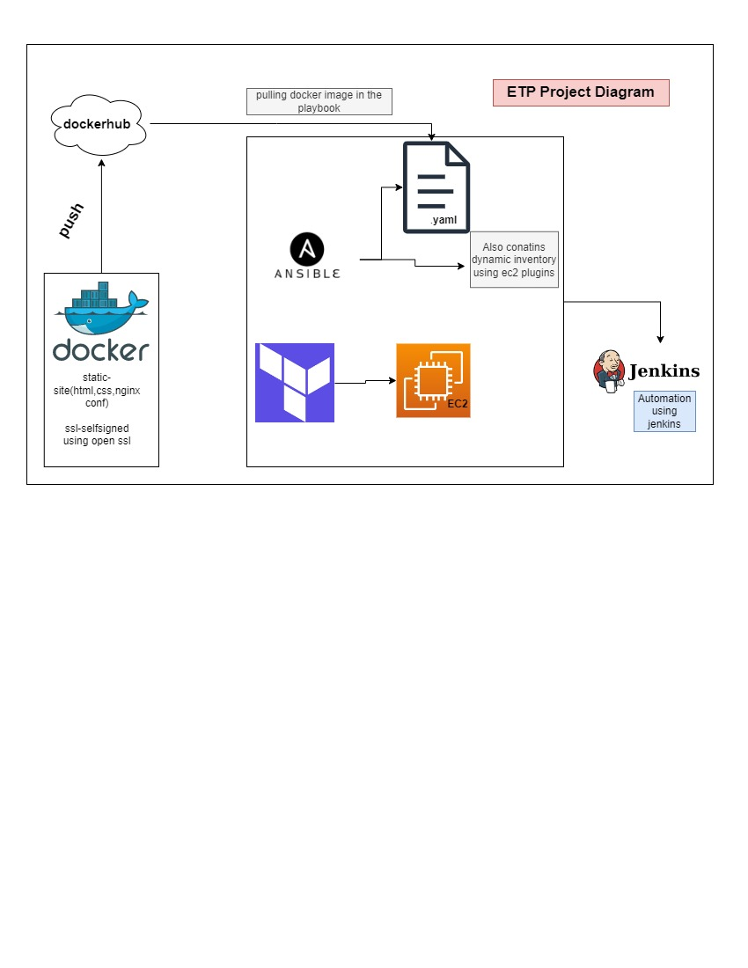
Project Architectured design.

Slide 3
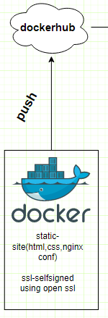
Configuring Nginx along with self signed SSL certificate in docker file ,building it and pushing it in the docker hub so that it can be pull in the upcoming playbook file.

Slide 4

Using Terraform ,creating Ec2 machine in AWS.

Slide 5
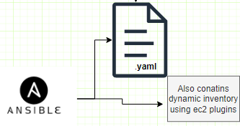
Using Ansible ,configuring the dynamic inventory with the help of aws ec2 plugin and writing the playbook.

Slide 6
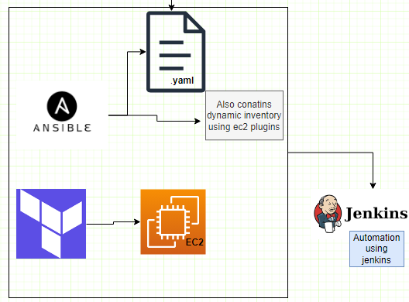
Automation using Jenkins

Slide 7
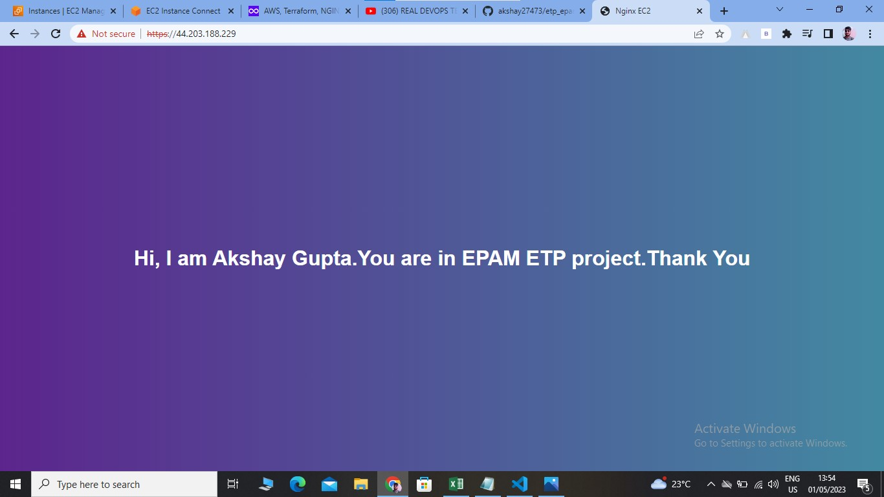
OUTPUT

Slide 8
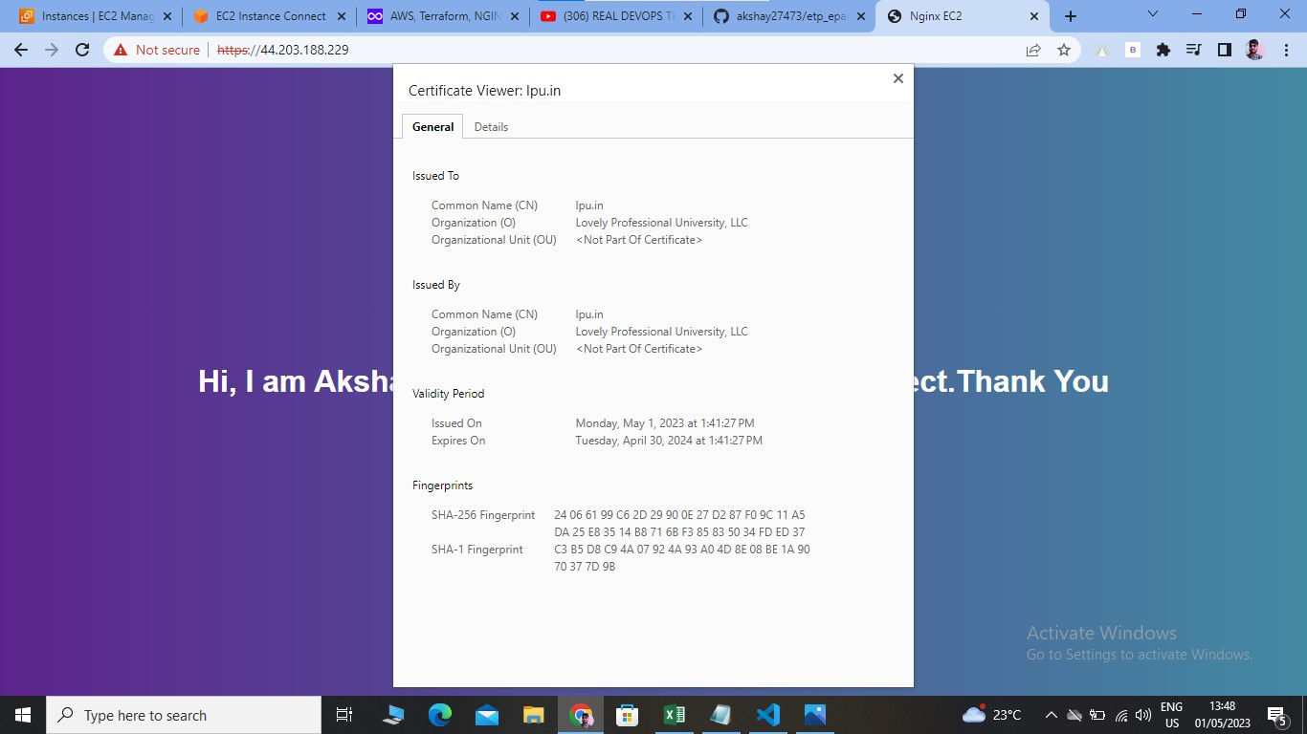
OUTPUT

Slide 9
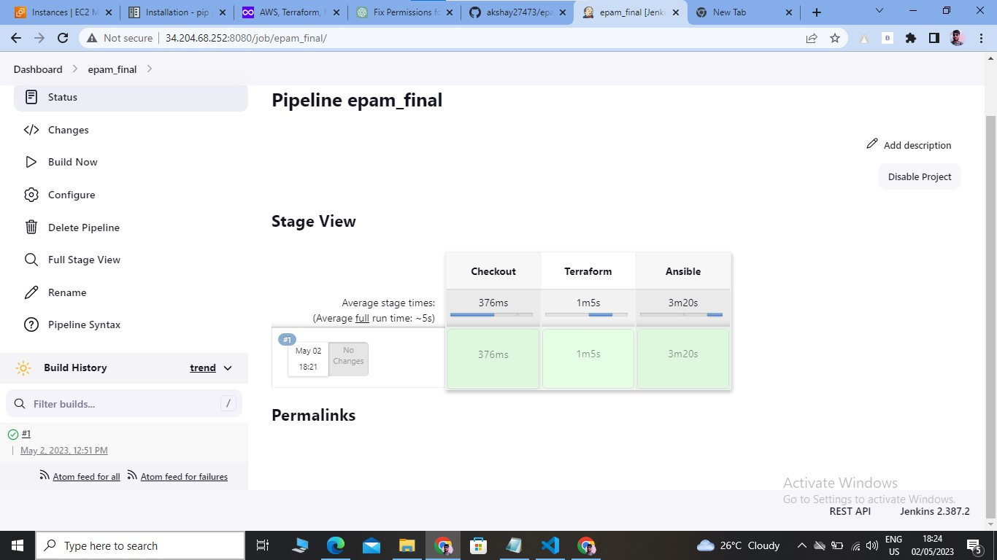
OUTPUT

Slide 10


